Slide 1


CyberGirls4.0 FinalProject Defense
Developing An Automated Incident Detection and Response System Using Open-Source Tool
Group 5
Names:
Kate Amarachukwu Igwilo
Gamuchirai Blessing Muchafa
Rashida Yakubu
Chianu-Okoli Chinemerem
Omote Ella Oboakpororo

Slide 2



Project Aim and Objective Introduction and Overview Overview of Wazuh Wazuh Architecture
Setting Up The Environment
Automated Incidence Detection and Response Testing and Validation
Result and Analysis Lesson Learned Conclusion
Questions and Answers
Outline

Slide 3

INTRODUCTION
Aim
To Create an Automated System that can Detect, Analyze, and Respond to Security
Incidents Using Wazuh in Real-Time
Objective
Gaining in-depth knowledge of how wazuh collects, processes and Analyzes Security Data.
Develop rules for detecting suspicious Activities and implement automated actions.

Slide 4


Introduction and Overview
Incidence response automation refers to the use of rule-driven logic, machine learning, and AI to automatically analyse and correlate data from different sources to identify and detect incidents that threaten an organization.
It also automatically completes routine, standardised tasks to expedite the incident process and increase the Security team’s efficiency and effectiveness.
The project focuses on designing and developing an automated system capable of detecting, analyzing, and responding to security incidents in real-time.

Slide 5


Overview of Wazuh
Wazuh is an Open-source security platform for threat detection, monitoring, and incident response.
It includes features like log analysis, file integrity monitoring (FIM), vulnerability detection, and security analytics.
The Key Components of The Wazuh Open-source tool are:
Wazuh Agent: Installed on monitored endpoints to collect logs and data.
Wazuh Manager: Processes data, applies detection rules, and generates alerts.
Wazuh Dashboard: Web interface for visualizing alerts and managing configurations.
It works with Elasticsearch and Kibana for enhanced search and data visualization.

Slide 6
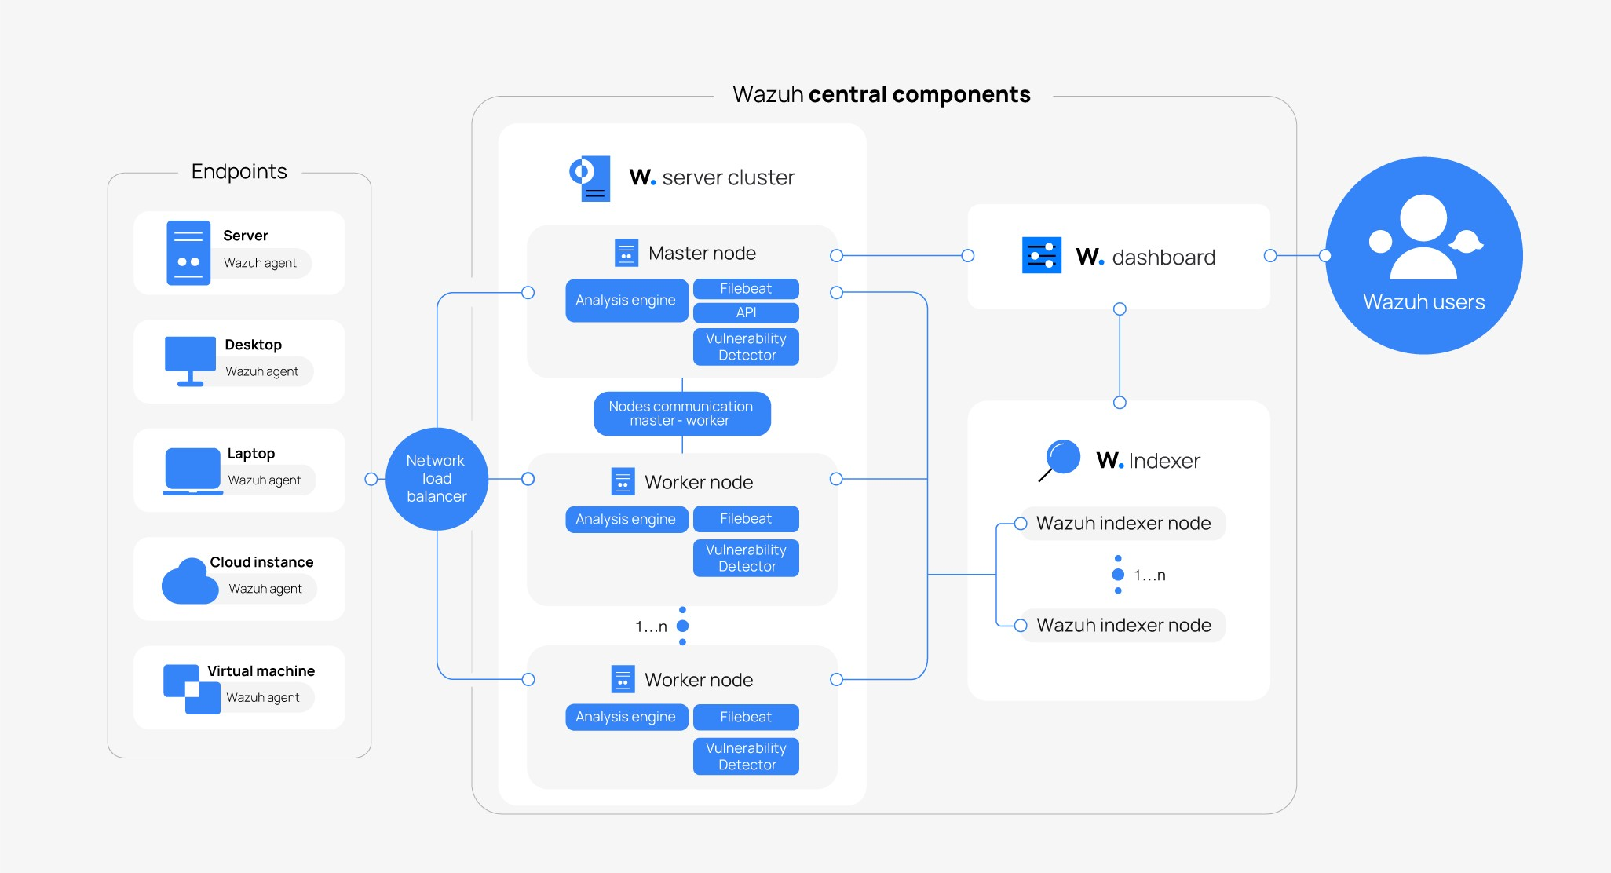

Wazuh Architecture
Wazuh Agents on endpoints (e.g., servers, workstations).
Wazuh Manager for data processing.
Elasticsearch for storing event data.
Kibana Dashboard for visualizing alerts and trends.

Slide 7

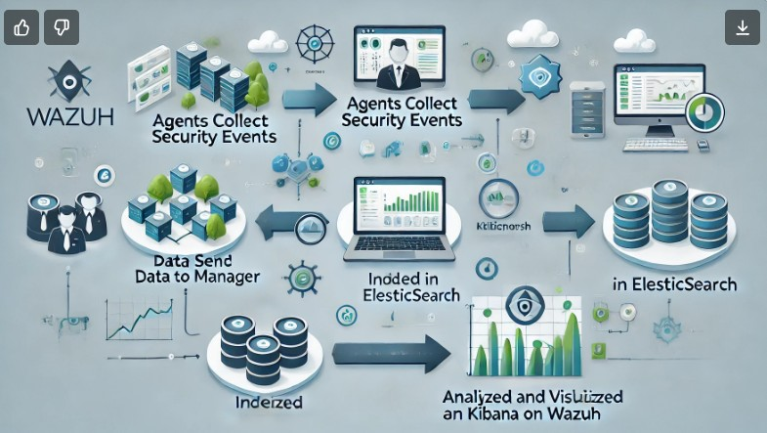
Data Flow
Agents collect security events → Data sent to Manager → Indexed in Elasticsearch → Analyzed and visualized in Kibana on Wazuh

Slide 8

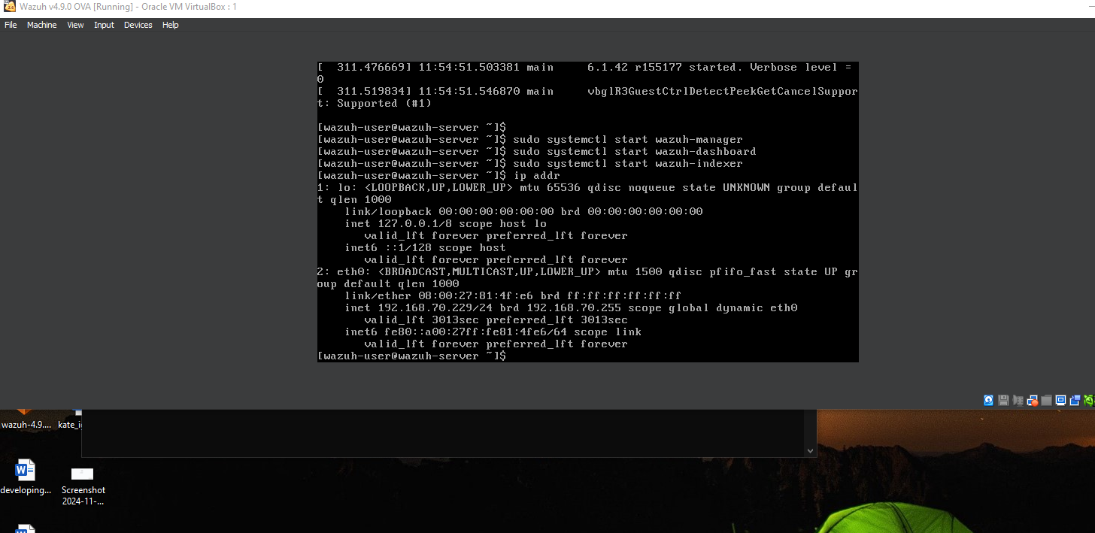
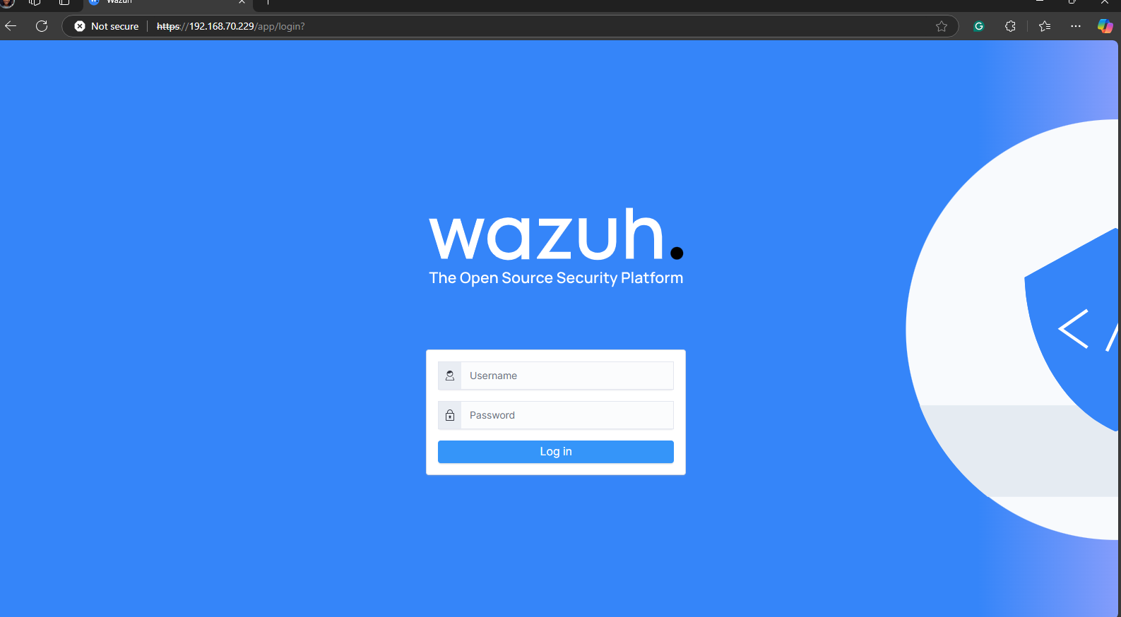
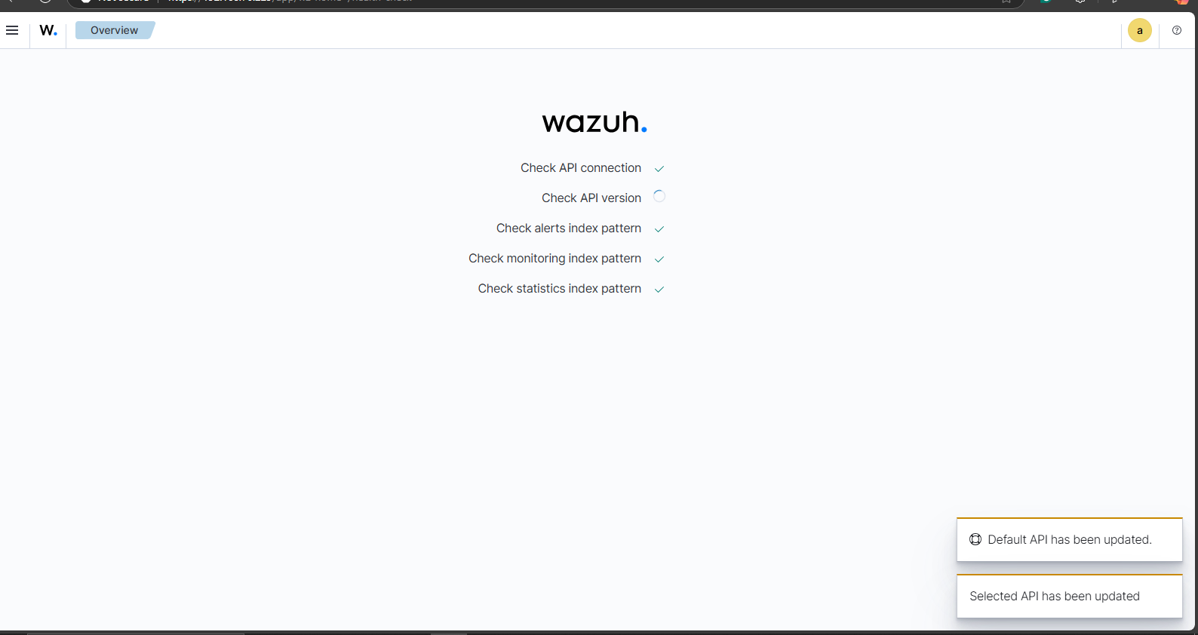
SETTING UP THE ENVIRONMENT Deploying the Wazuh Manager

Slide 9
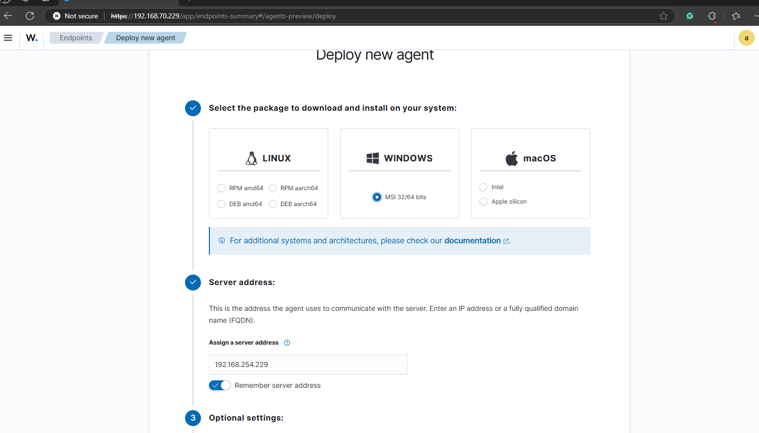
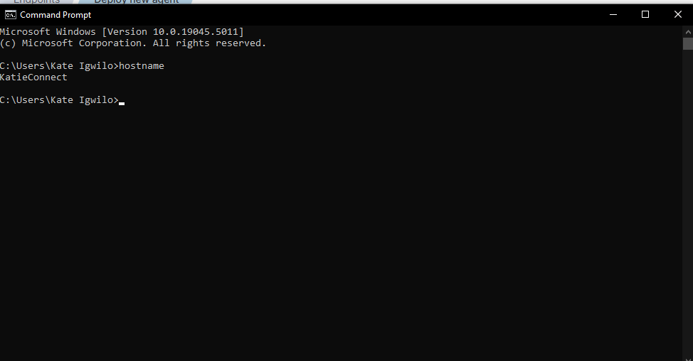
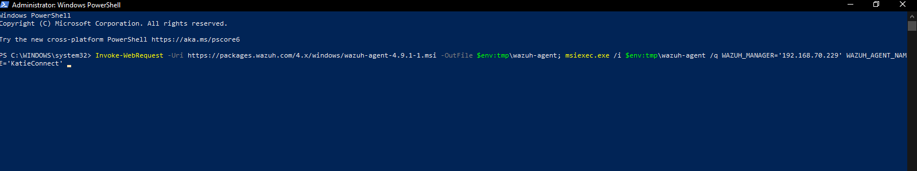
SETTING UP THE ENVIRONMENT Deploying New Agent

Slide 10
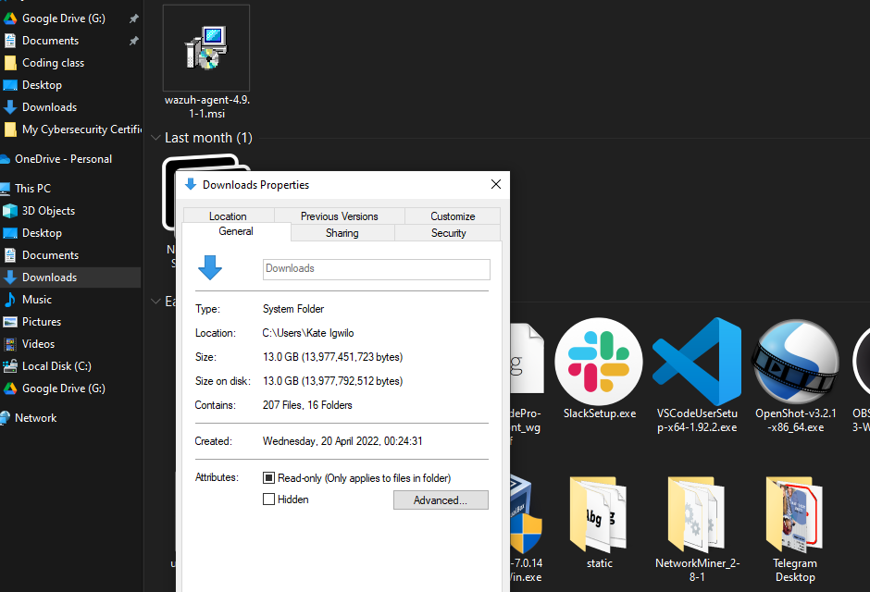
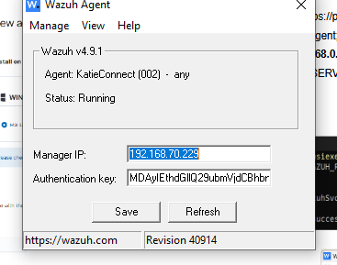
Setting Up the Environment

Slide 11
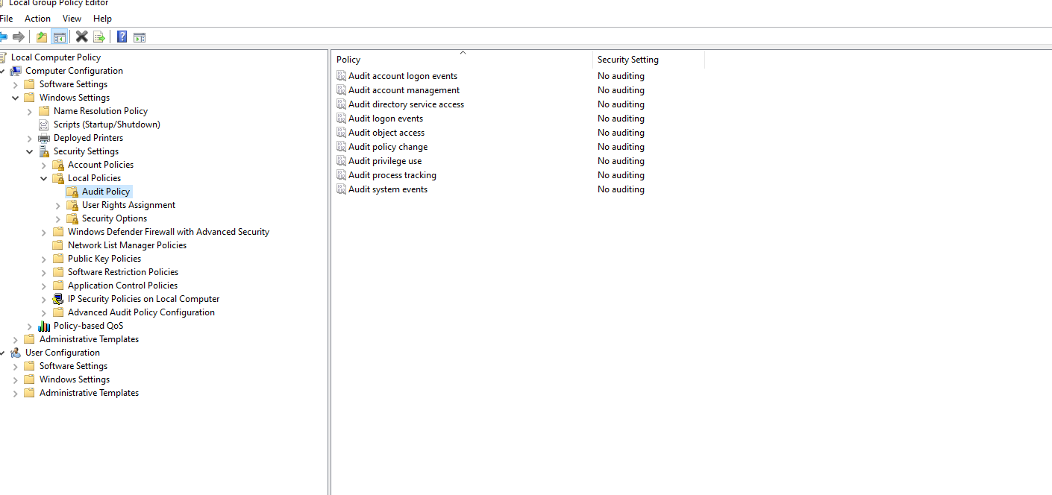
Setting Up The Environment

Slide 12
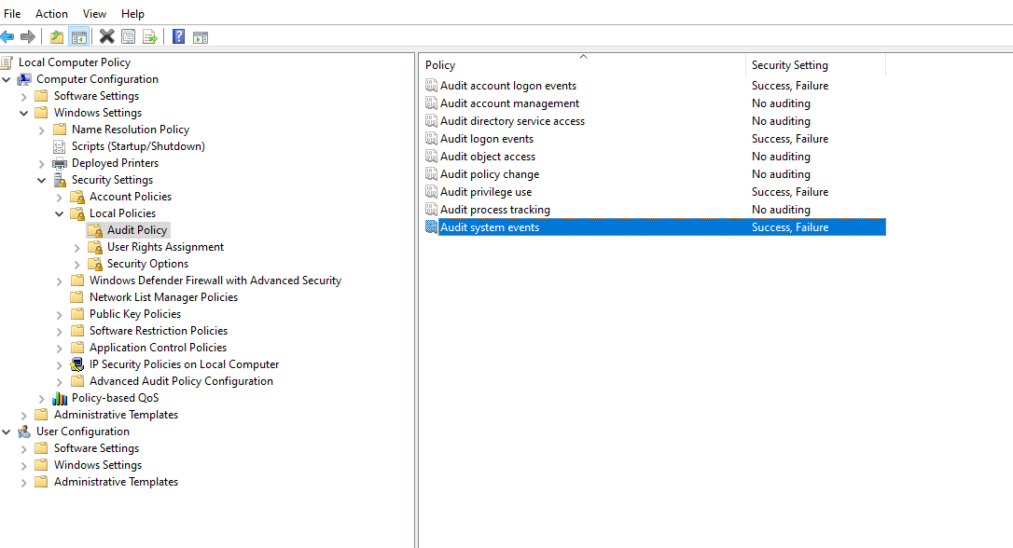
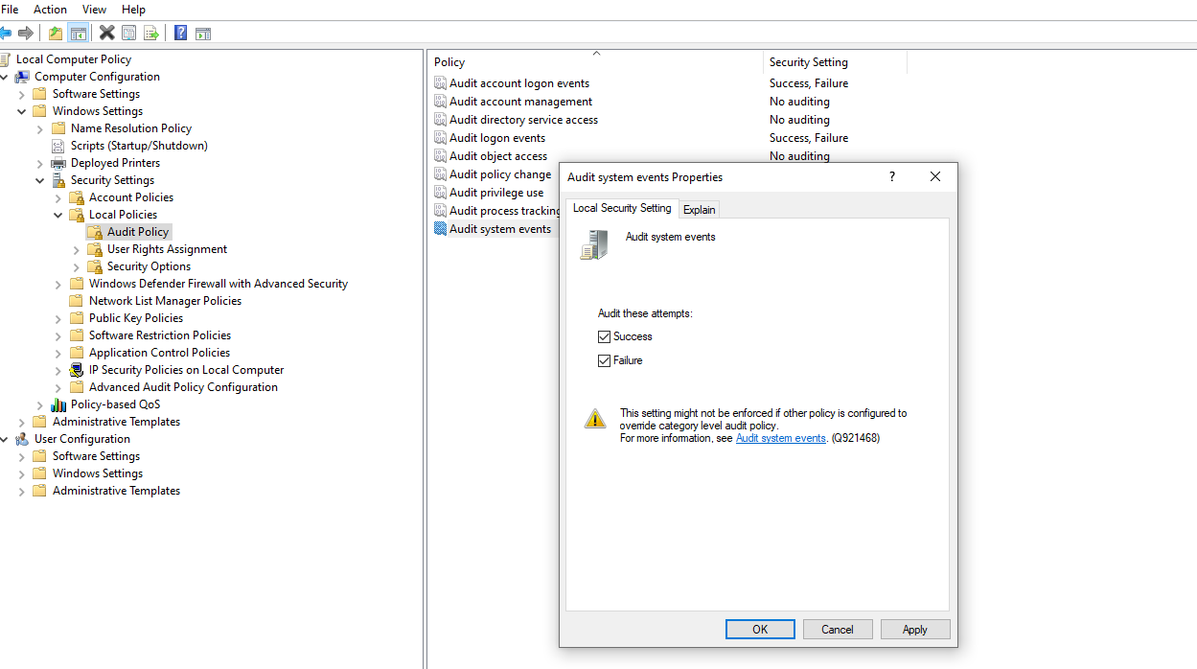
Setting Up The Environment

Slide 13
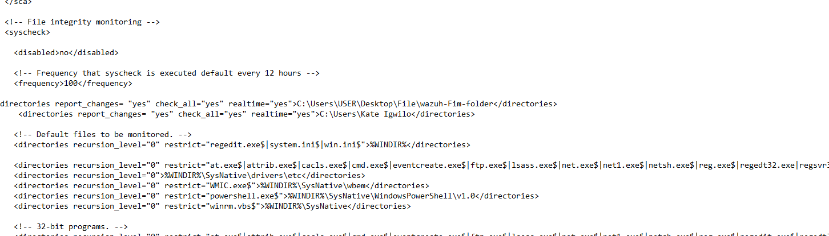
File Integrity Monitoring Setup

Slide 14
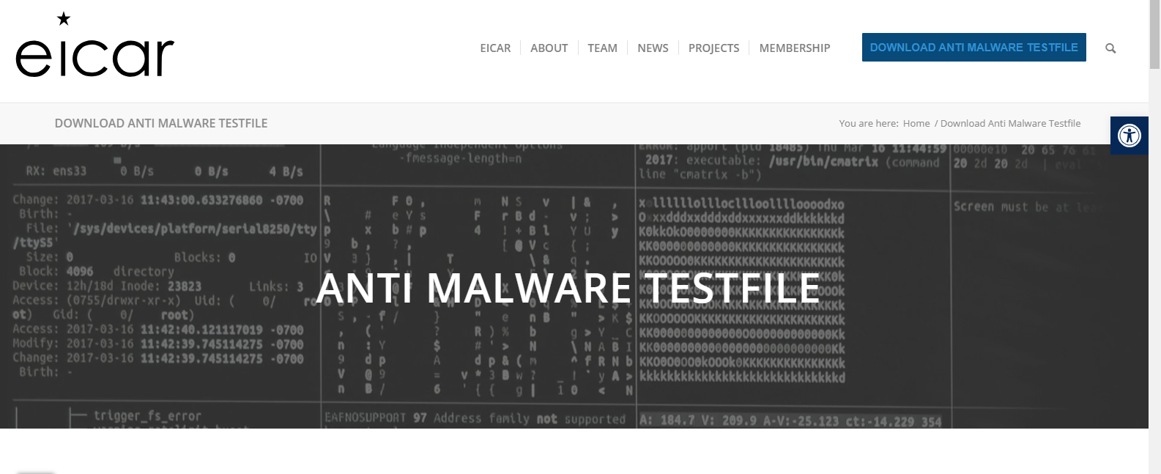
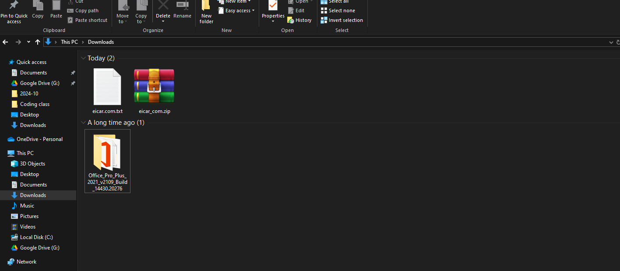

Scenario 1: Eicar file

Slide 15
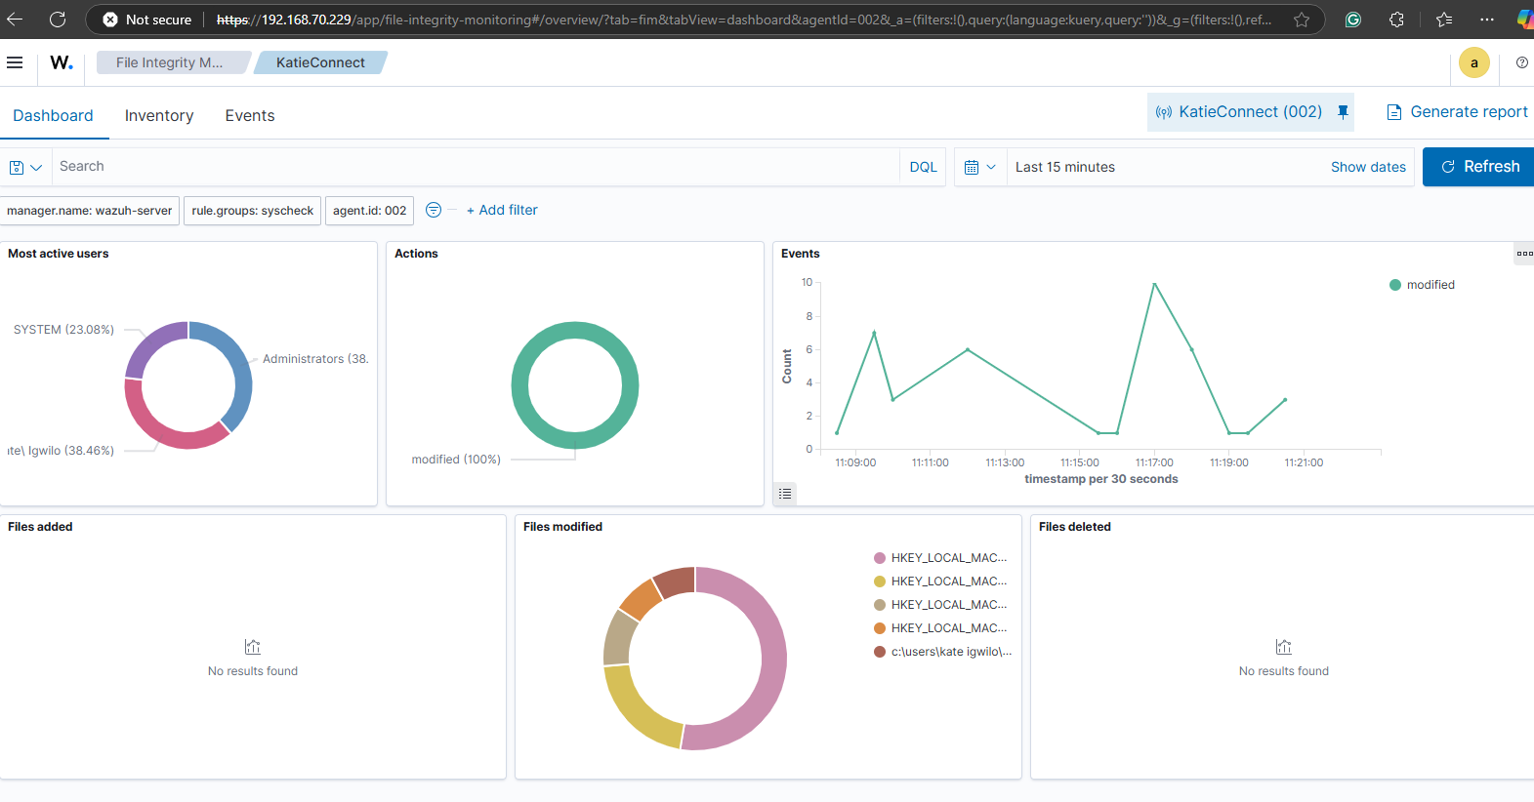
File Integrity Dashboard

Slide 16
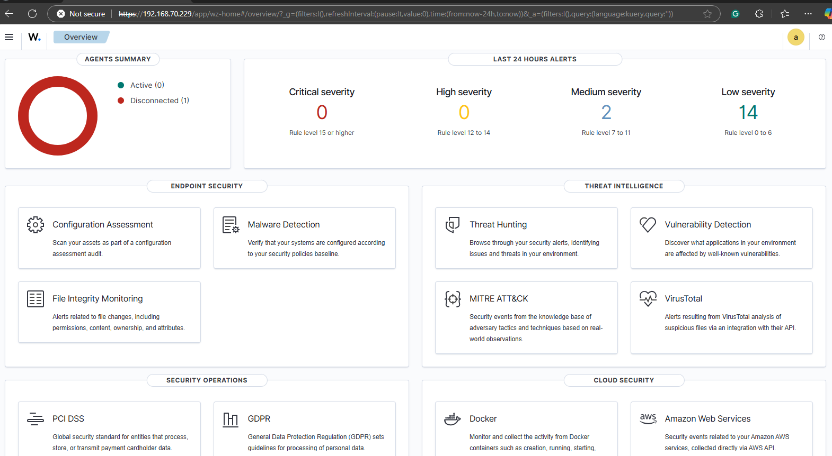
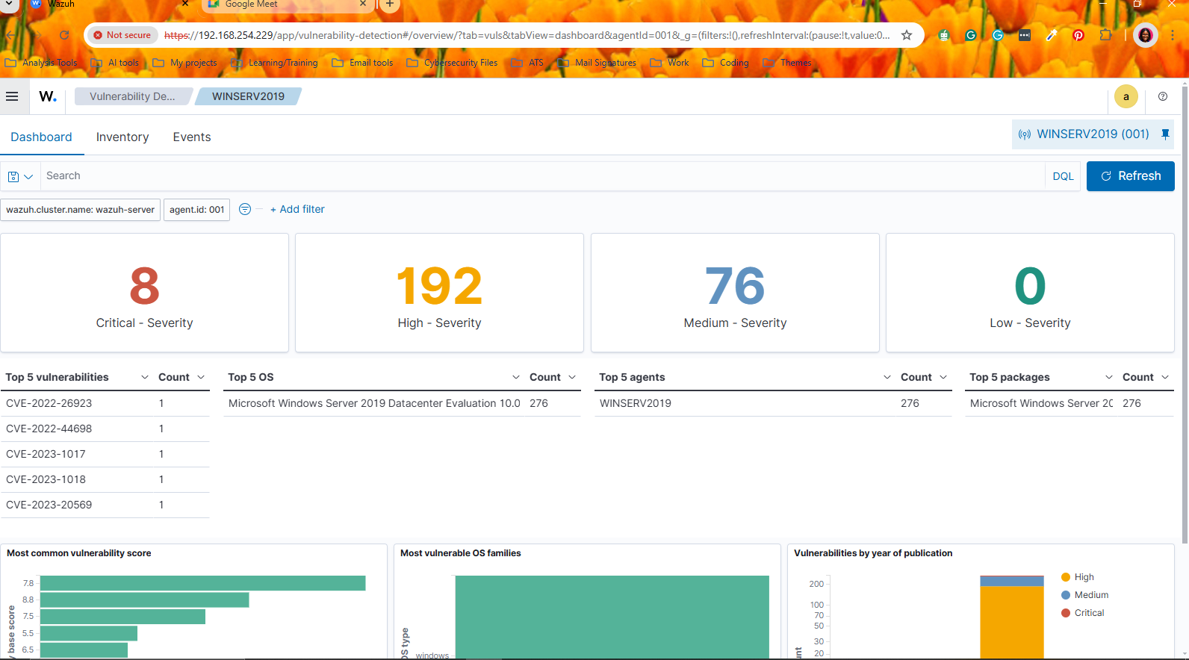
Automated Incident Detection and Response
File Integrity Monitoring

Slide 17
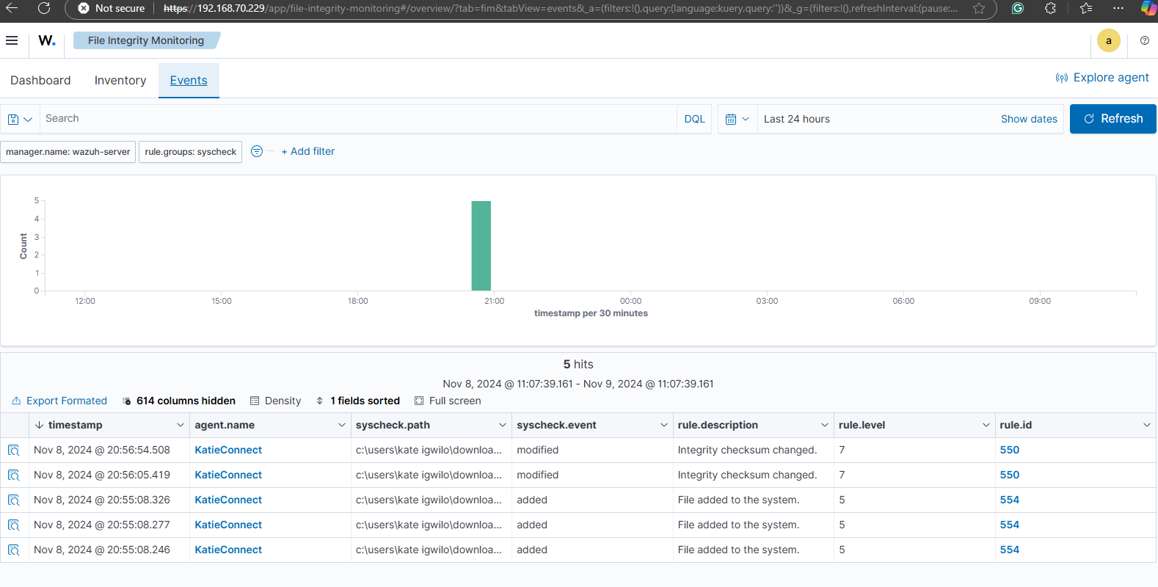

Slide 18
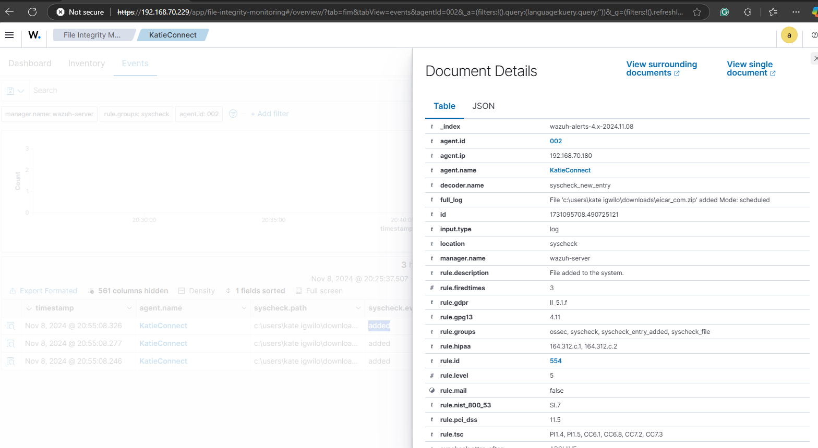
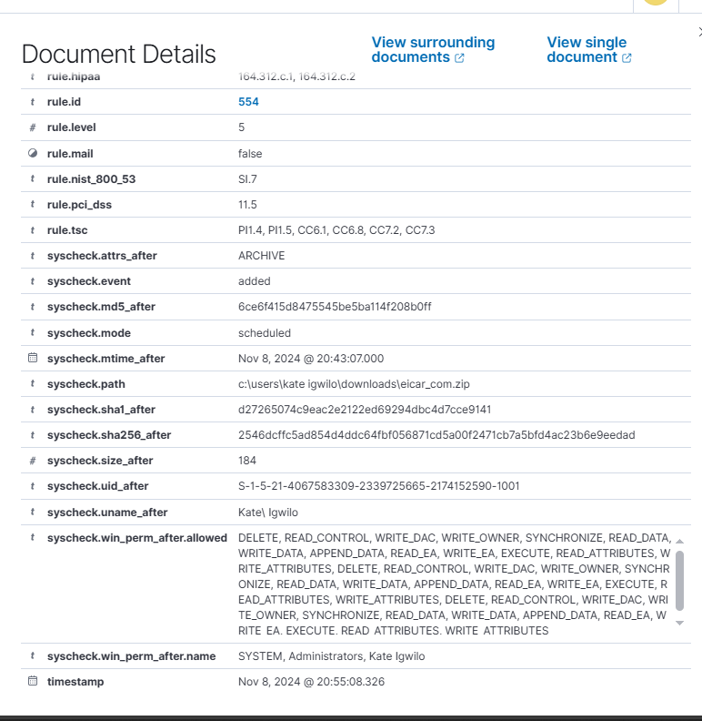
Eicar File Detection

Slide 19
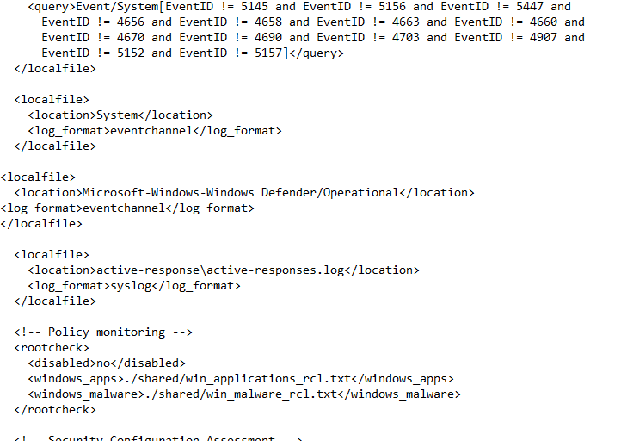
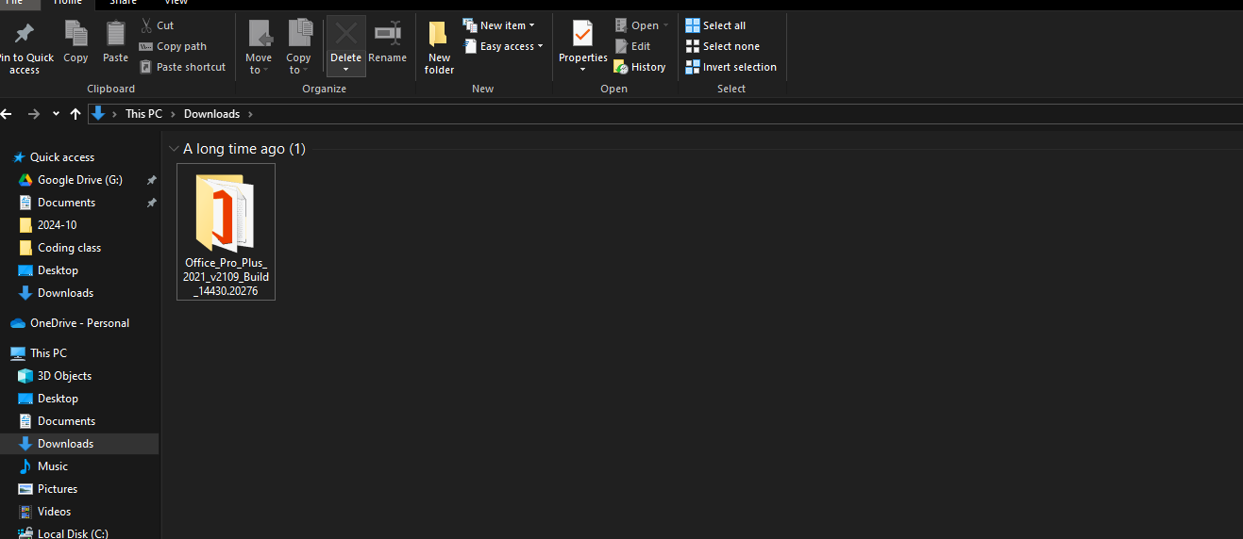
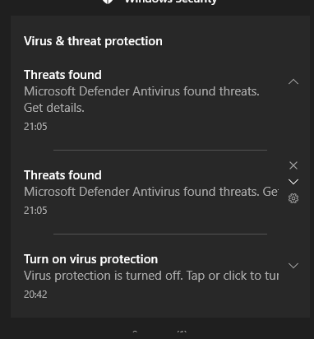
Integration of Microsoft Defender

Slide 20
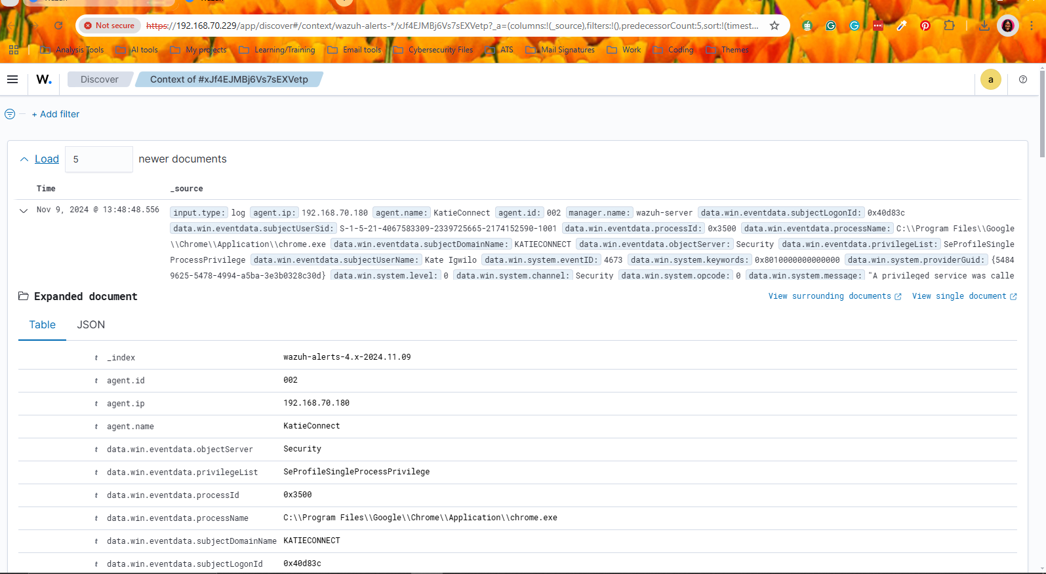
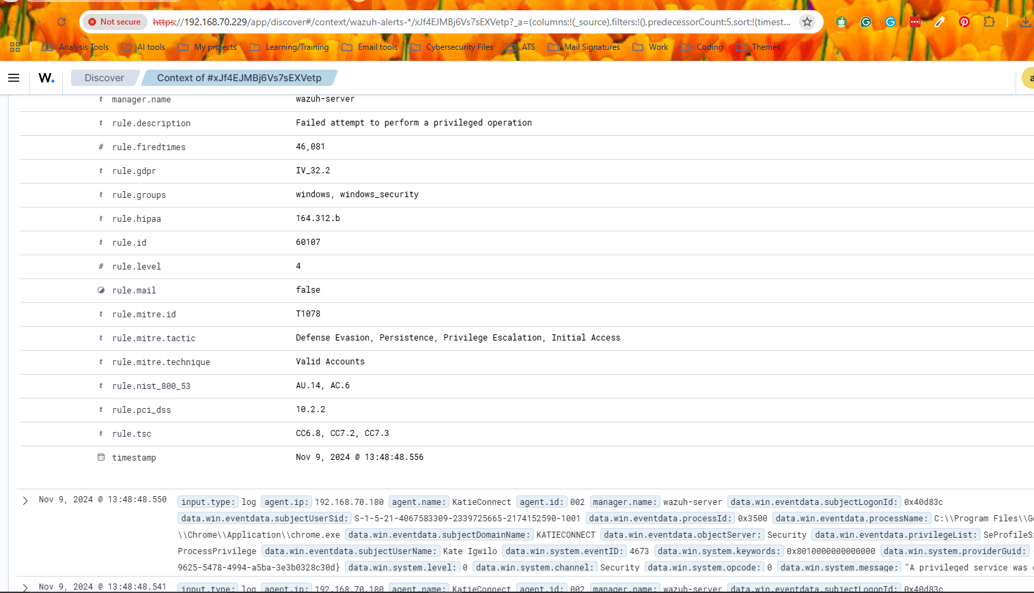
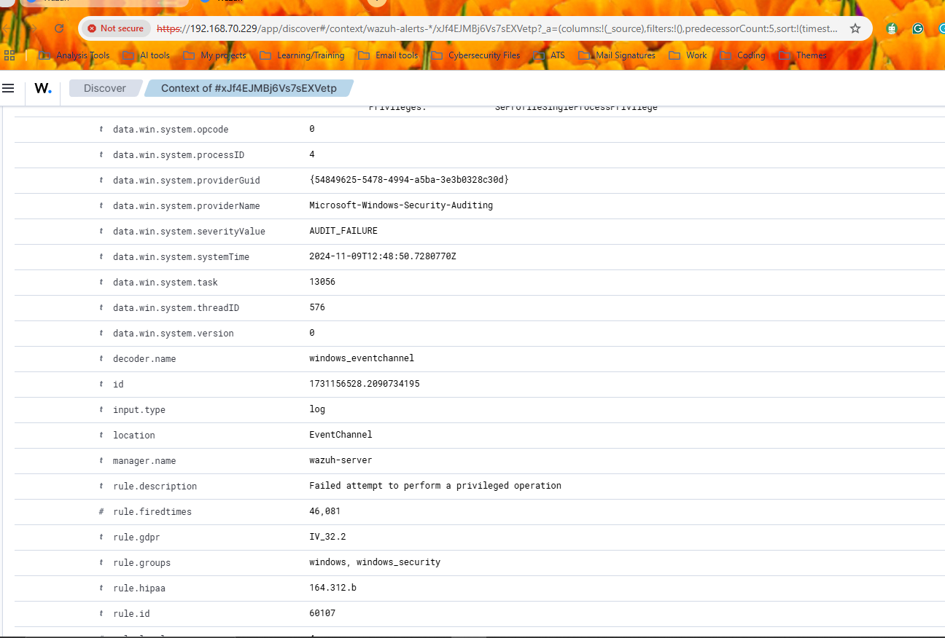
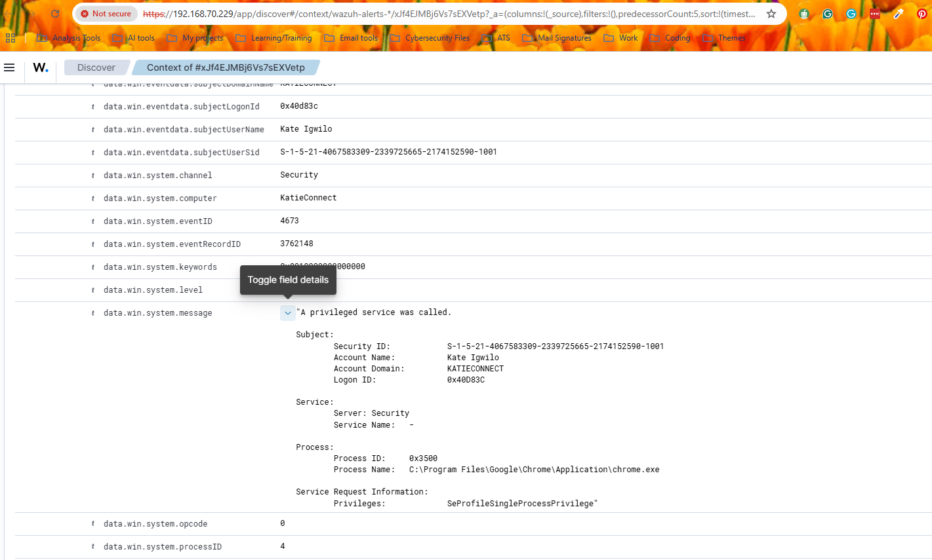
Automated Incident Detection and Response

Slide 21
Scenario 2: Hydra Attack

Slide 22
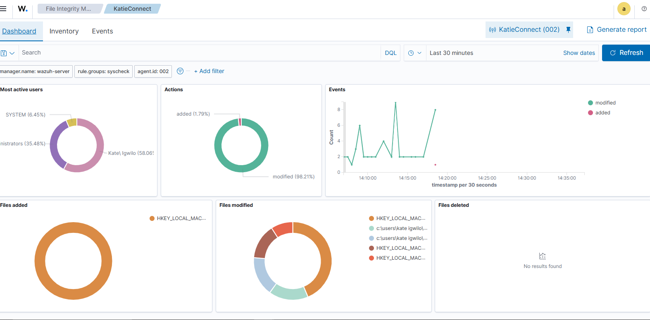
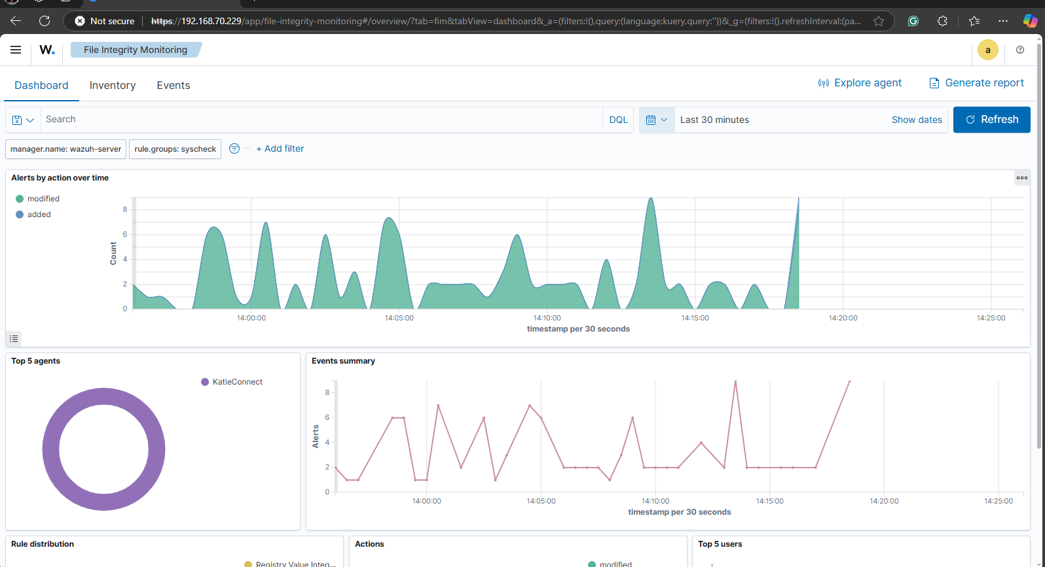
Hydra Attack

Slide 23
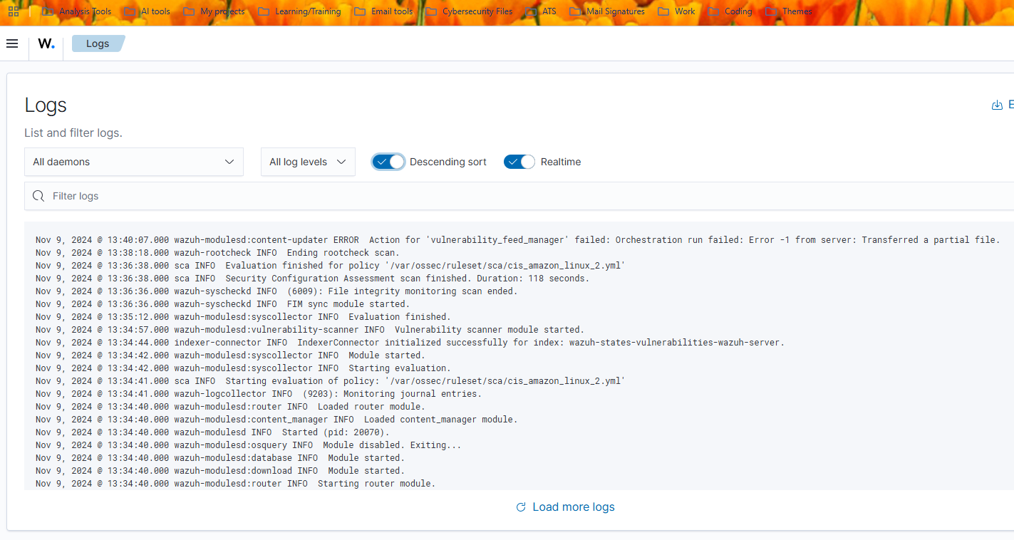
Hydra Attack

Slide 24
LESSON LEARNED
Technical Skills Developed: SIEM configuration, log analysis, rule development, and automation scripting.
Best Practices: Importance of regular rule updates, testing in different environments, and continuously refining the system.

Slide 25
Conclusion
·Summary of Project: Recap of key achievements in building an automated incident detection and response system using Wazuh.
·Key Takeaway: Demonstrated how open-source tools can provide robust security solutions for real-time incident response.

Slide 26


REFERENCES
Auto Block Malicious IPs With Wazuh’s Active Response
https://opensecure.medium.com/auto-block-malicious-ips-with-wazuhs-active-response-21603e653673 Blocking SSH brute-force attack with active response
https://documentation.wazuh.com/current/user-manual/capabilities/active-response/ar-use-cases/blocking-ssh- brute-force.html
Blocking SSH brute-force attack with active response
https://documentation.wazuh.com/current/user-manual/capabilities/active-response/ar-use-cases/blocking-ssh- brute-force.html
Threat Detection & Active Response With Wazuh https://www.youtube.com/watch?v=vJZAVZOIpfA

Slide 27
QUESTIONS AND ANSWERS
Questions and Discussion: Floor is open for any questions from the audience.

Slide 28

ThankYou

